Slide 1
Introduction to Cloud Computing
Στα πλαίσια του μαθήματος Τεχνολογία Λογισμικού 2017-2018
Από το φοιτητή Τζιβάκη Δημήτρη

Slide 2
Index
What is Cloud Computing?
History of Cloud Computing
The architecture of Cloud Computing
Fundamentals Services
Common Deployment Models
Privacy and Security Issues

Slide 3
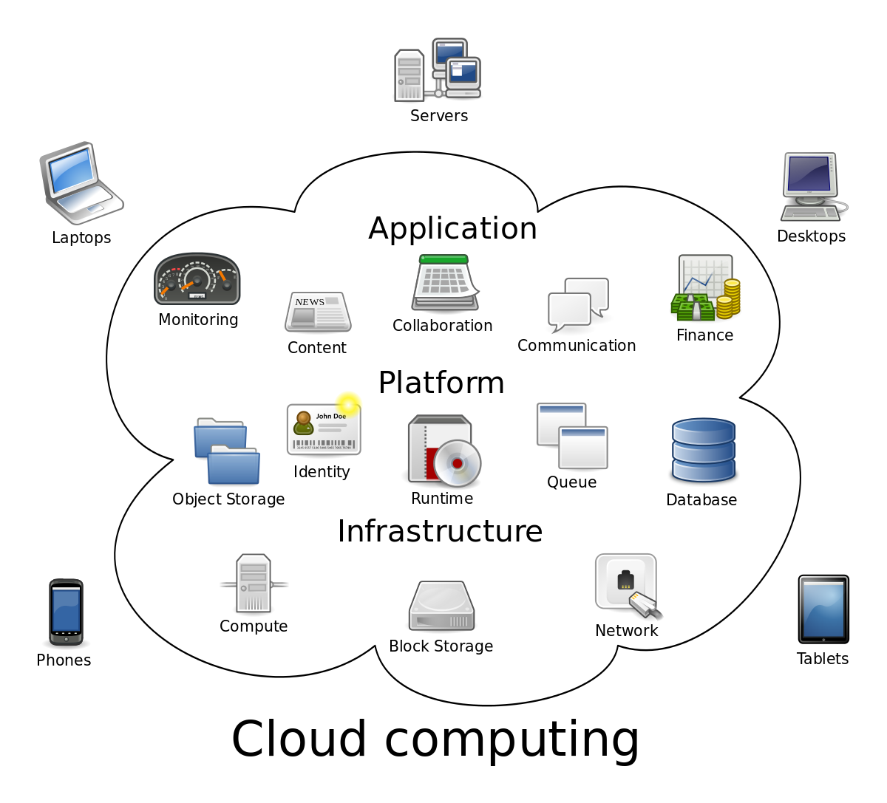
What is Cloud Computing
The idea of separating applications from operating systems and hardware that runs everything.
The Cloud provides services over network and solutions to run those services.
Email, web conferencing etc. all run in Cloud.
To understand it we must first understand Clustering!

Slide 4
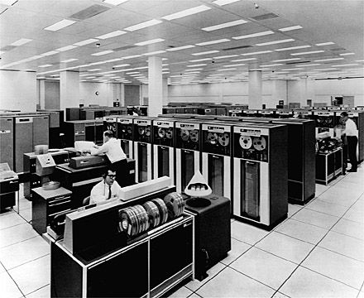
History of Cloud Computing
In the 60s-70s there were only Mainframes and Dumb Terminals(5-1000)
Each Mainframe had certain amount of processing power and gave very little time to each terminal!

Slide 5
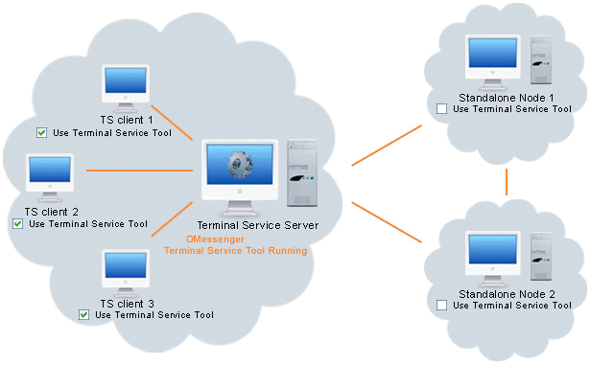
Terminal Services and Thin Clients
What Mainframes came to be. We connect to Terminal Service Servers using Thin Client Software. Need only enough power to connect to the Terminal Service Server
Same idea is with the Application Servers.
Instead of connection to an OS you connect to a specific application on a server.

Slide 6
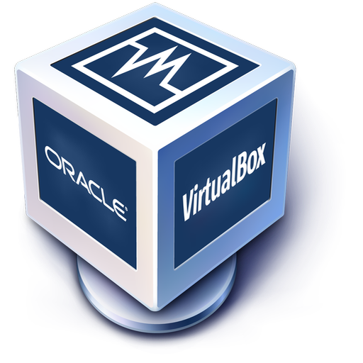
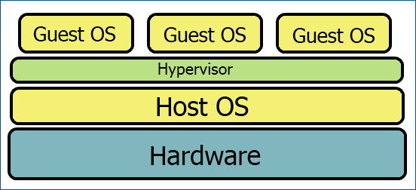
Virtualization
Client Installed
Install an OS on a piece of hardware and install cloud virtualization software on top of it.
Really easy to transfer!
Hypervisor
Install the Hypervisor on the hardware and use a Management Software to manage/connect to it
Basically what you see is just an IP address

Slide 7
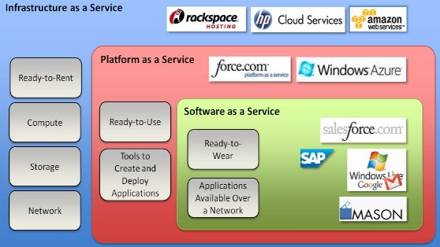
Architecture
Refers to the components and subcomponents required for cloud computing.
These typically are a front end platform, back end platforms, a cloud based delivery and a network(Internet, Intranet, Intercloud).

Slide 8
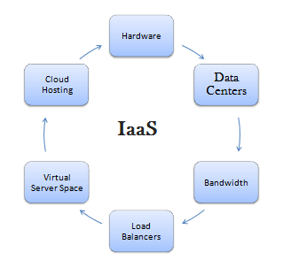
Infrastructure as a Service(IaaS)
IaaS provides offer computers (physical or virtual) with virtual machines being run as guests by a Hypervisor(Xen or KVM).
Supports large numbers of virtual machines and ability to scale according to demand
To deploy their applications cloud users install operating system images and their application software on the cloud infrastructure. The cost reflects the amount of resources allocated and consumed. For that reason you can easily go past your budget!
Windows Azure Virtual Machines, DynDns, Google Compute Engine, HP Cloud, Terremark, Amazon CloudFormation, Amazon EC2 etc

Slide 9
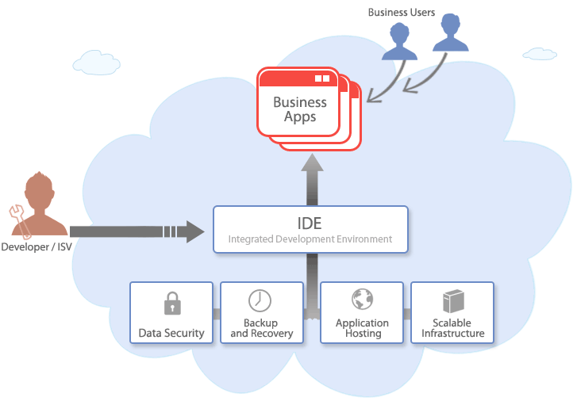
Platform as a Service (PaaS)
Cloud providers deliver a computing platform including an operating system, an IDE, a database and a web server.
Develop without the cost of buying and managing hardware and software!
Scales to match application demand
Amazon Elastic Beanstalk, Cloud Foundry, Heroku, Force.com, Google App Engine, WIndows Azure Compute etc

Slide 10
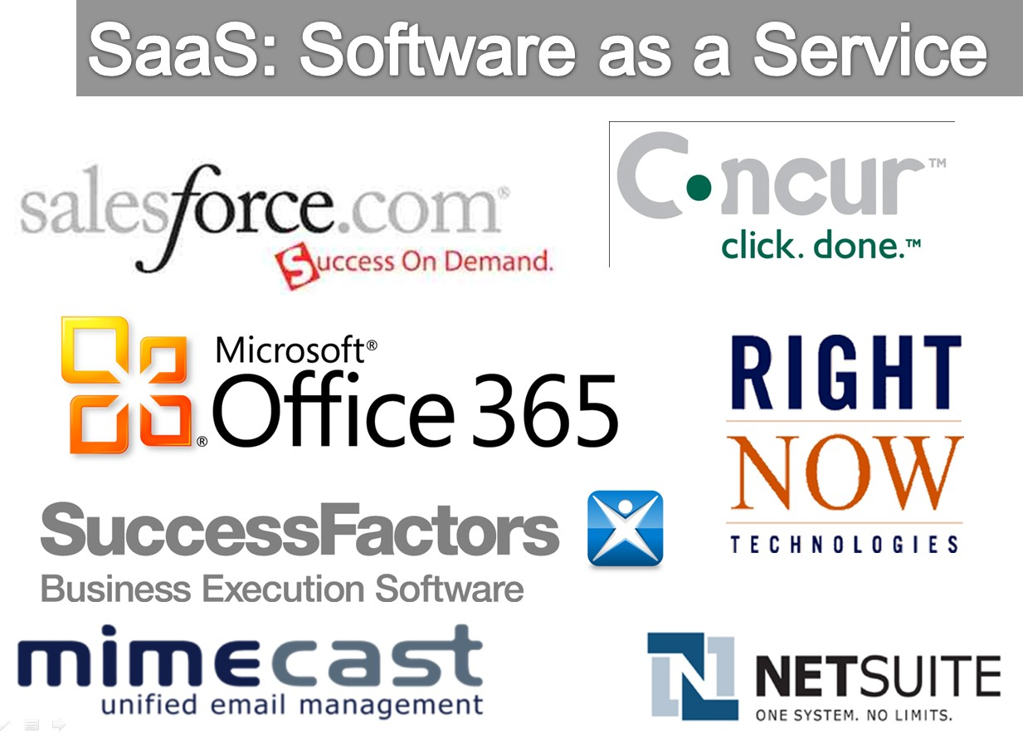
Software as a Service (SaaS)
Cloud users access the software that cloud clients have installed in the cloud.
It is really powerful because it is extremely scalable. Tasks can be cloned onto multiple virtual machines at run-time to meet the changing work demand. Load Balancers distribute the work over the set of virtual machines
Monthly or yearly adjustable pricing model
Google Apps, Microsoft Office 365, GT Nexus, etc

Slide 11
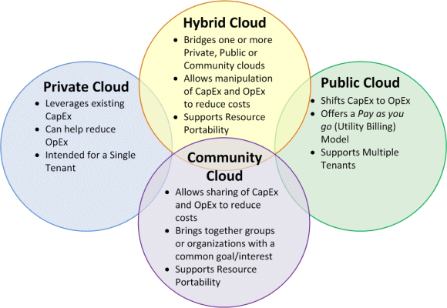
Common Deployment Models
Public Cloud : Available to the general public for large industry groups sold as a service
Community Cloud : Shared by several organisations
Hybrid Cloud : A mix of Private, Public or Community Clouds
Private Cloud : Not accessible by the general public

Slide 12
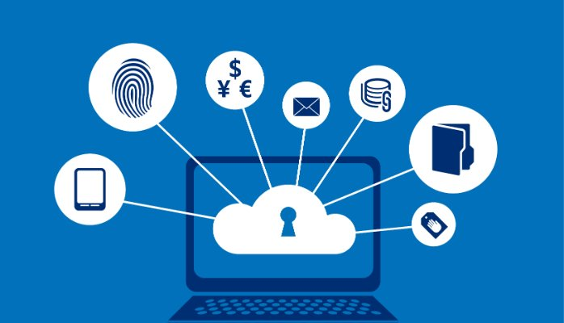
Privacy Issues
Only a handful of companies can host cloud services and for that reason only a few of them can control and monitor at will the communication between the host company and the end user. That means their data too!
Remember NSA working with AT&T and Verizon recording over 10 million telephone calls.

Slide 13

Security Issues
Physical Control of the private cloud equipment is more secure than having the equipment off site and under someone else’s control, being manage by them. You cannot inspect the data links or access ports to ensure that there are no compromisations.
Solutions to the cloud security issues vary from cryptography, particularly public key infrastructure(PKI) to use of multiple cloud providers, standardisation of APIs and impoving virtual machine support.

Slide 14
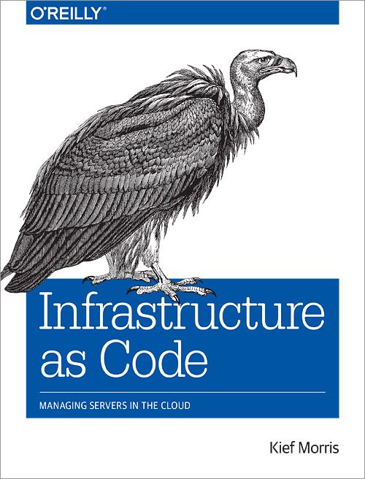
Infrastructure
as Code

Slide 15
References/Sources
http://en.wikipedia.org/wiki/Software_as_a_service
http://www.oracle.com/us/dm/powering-generation-278787.pdf
http://www.akro.com.au/akroimages/documents/gartner_report_december_11_tech_trends_dcappuccio.pdf
http://www.slideshare.net/liuliming/introduction-to-cloud-computing-presentation
Youtube’s “Eli the Computer Guy”

